Slide 1




MBC 638: Data Analysis & Decision Making
Anna Chernobai
Lecture 14:
Time series and forecasting (Chapter 12)

Slide 2

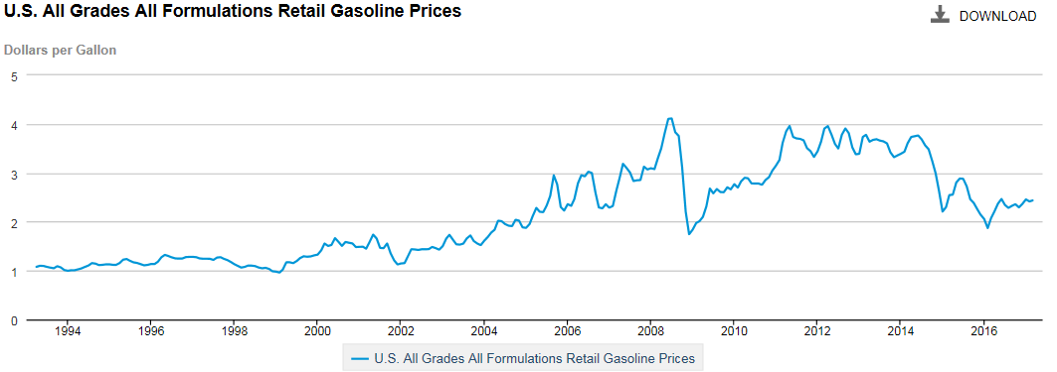

Can we predict future gasoline prices?
U.S. Energy Information Administration
https://www.eia.gov/dnav/pet/hist/LeafHandler.ashx?n=PET&s=EMM_EPM0_PTE_NUS_DPG&f=M
U.S. All Grades All Formulations Retail Gasoline Prices

Slide 3
In this lecture:
What is time series modeling?
Forecasting: extrapolation methods
Two simplest extrapolation methods
Use last period’s data as the forecast for next period
Use the average of all historical data as the forecast for next period
Moving Average extrapolation
Simple Moving Average (MA) of order k
Weighted Moving Average
Exponential Smoothing extrapolation
Exponential Smoothing with smoothing constant α
Forecasting: regression-based methods
Time series regression model with trend
Time series regression model with seasonality
Controlling for other causal variables
Autoregression (AR) model of order k
Forecast accuracy: error metrics
Mean Absolute Error (MAE)
Mean Square Error (MSE)
Root Mean Square Error (RMSE)

Slide 4
1. What is time series modeling?
Time series = a sequence of measurements of the same variable obtained over a period of time.

Slide 5
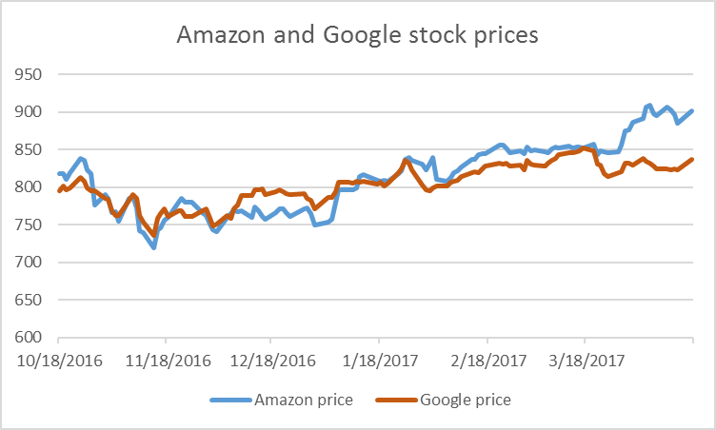
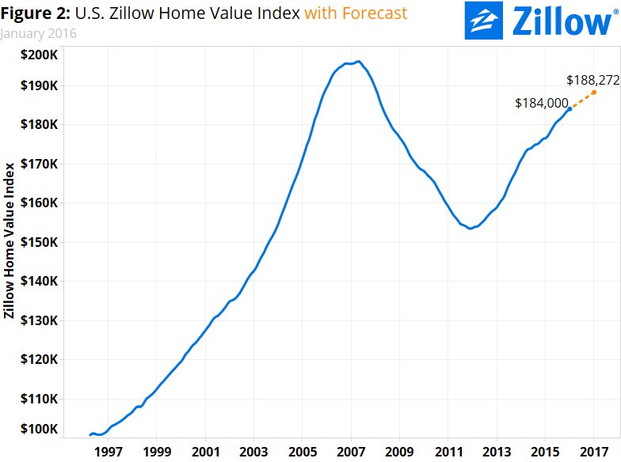
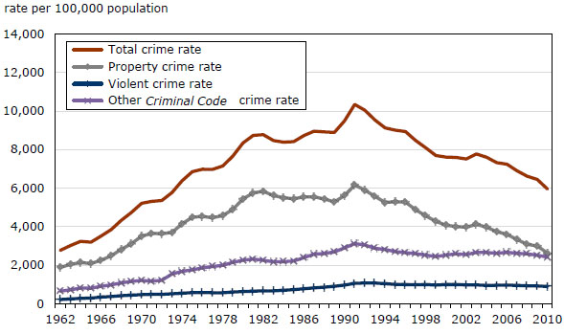
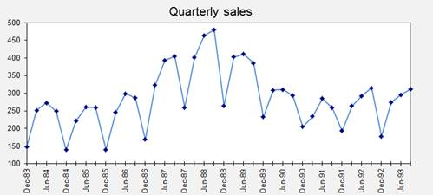
1. What is time series modeling?
Time series = a sequence of measurements of the same variable obtained over a period of time.
Home values
Stock prices
Quarterly sales
Crime rate

Slide 6
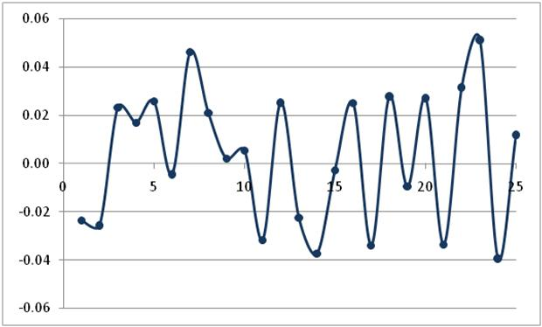
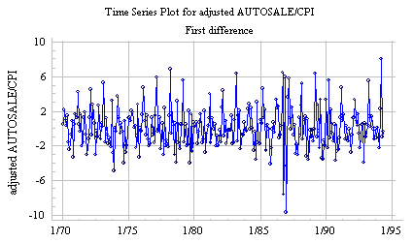
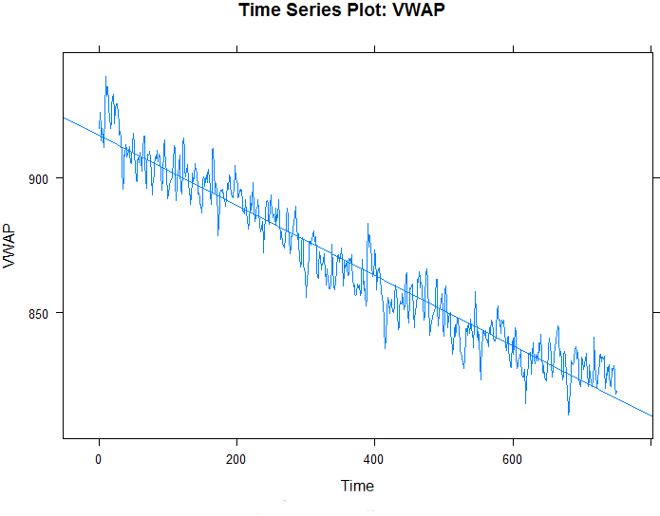
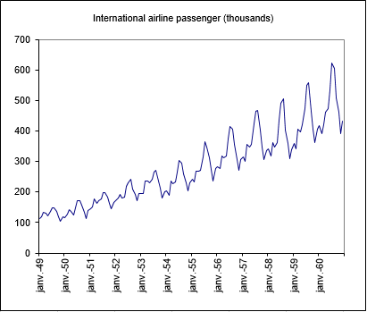
1. What is time series modeling?
Time series types
No trend
Volatility remains the same
Upward/downward trend
Linear or nonlinear trend
Cyclicality (seasonality)
Cyclicality and trend
Cyclicality + trend + increasing volatility

Slide 7
1. What is time series modeling?
Stationary time series = time series that are relatively constant and exhibit only random behavior.
“Relatively constant” means that the mean and volatility remain approximately the same over the time period.

Slide 8
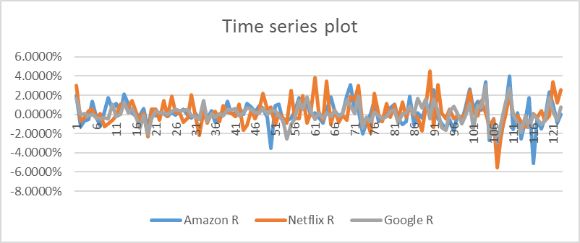
1. What is time series modeling?
Stationary time series = time series that are relatively constant and exhibit only random behavior.
“Relatively constant” means that the mean and volatility remain approximately the same over the time period.
STATIONARY
No trend
Volatility remains the same
Stock returns
No trend (average ≈ 0)
Volatility remains the same.

Slide 9
1. What is time series modeling?
Stationary time series = time series that are relatively constant and exhibit only random behavior.
“Relatively constant” means that the mean and volatility remain approximately the same over the time period.
STATIONARY
No trend
Volatility remains the same
Stock returns
No trend (average ≈ 0)
Volatility remains the same.
However, when economy is not doing well, there’s more uncertainty in the market and stock returns typically become more volatile; so, not always stationary!

Slide 10
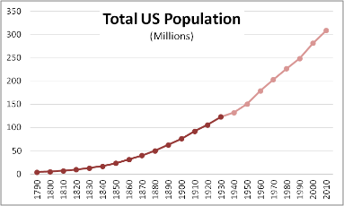
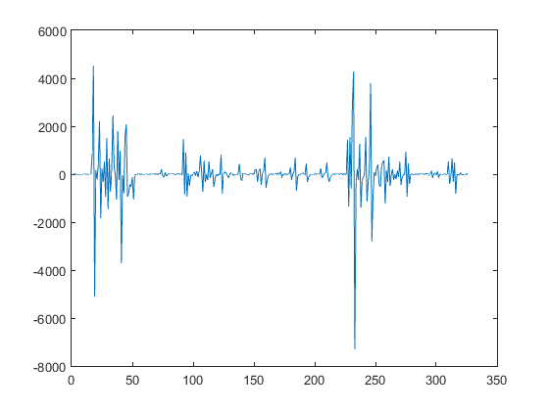
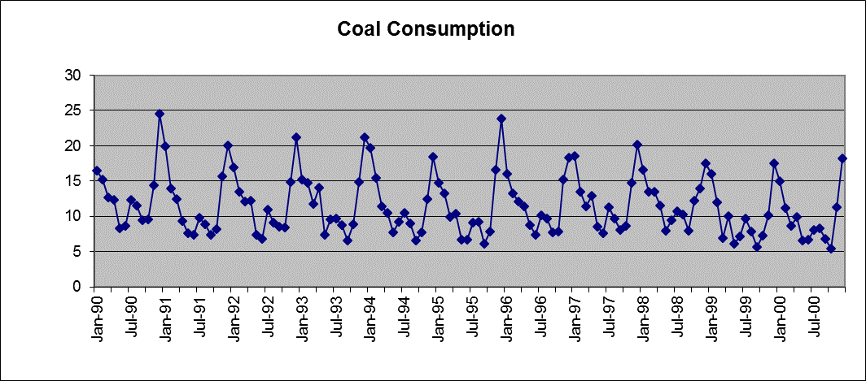
1. What is time series modeling?
Stationary time series = time series that are relatively constant and exhibit only random behavior.
“Relatively constant” means that the mean and volatility remain approximately the same over the time period.
NOT STATIONARY
Upward trend
NOT STATIONARY
No trend but volatility changes
NOT STATIONARY
cyclicality
NOT STATIONARY
Upward trend + cyclicality + volatility increases

Slide 11
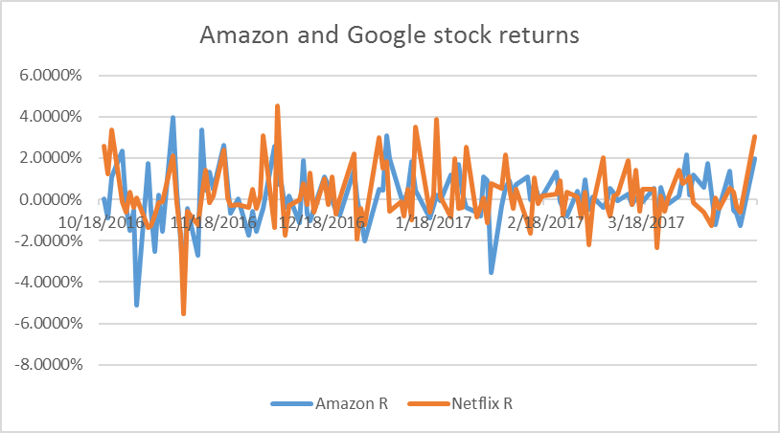
1. What is time series modeling?
Stationary time series = time series that are relatively constant and exhibit only random behavior.
“Relatively constant” means that the mean and volatility remain approximately the same over the time period.
Stock prices ($):
NOT STATIONARY
Stock returns (%):
STATIONARY

Slide 12
2. Forecasting: extrapolation methods
Forecasting techniques for STATIONARY data

Slide 13
In this lecture:
What is time series modeling?
Forecasting: extrapolation methods
Two simplest extrapolation methods
Use last period’s data as the forecast for next period
Use the average of all historical data as the forecast for next period
Moving Average extrapolation
Simple Moving Average (MA) of order k
Weighted Moving Average
Exponential Smoothing extrapolation
Exponential Smoothing with smoothing constant α
Forecasting: regression-based methods
Time series regression model with trend
Time series regression model with seasonality
Controlling for other causal variables
Autoregression (AR) model of order k
Forecast accuracy: error metrics
Mean Absolute Error (MAE)
Mean Square Error (MSE)
Root Mean Square Error (RMSE)

Slide 14

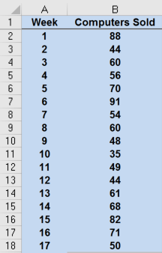
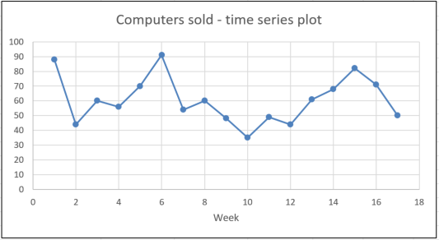
2. Forecasting: extrapolation methods
See Excel data: Tablet Computer Sales.xlsx
stationary

Slide 15
2. Forecasting: extrapolation methods
See Excel data: Tablet Computer Sales.xlsx
?
?
?
week 18 =??
stationary

Slide 16
2. Forecasting: extrapolation methods
Two simplest forecast methods:
Use this period’s data to forecast next period’s data
Intuitively:

Slide 17
2. Forecasting: extrapolation methods
Two simplest forecast methods:
Use this period’s data to forecast next period’s data
2. Use the average of all historic data to forecast next period’s data
Intuitively:
Intuitively:

Slide 18

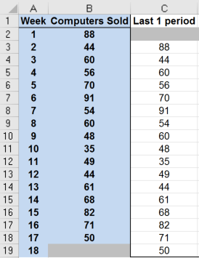
2. Forecasting: extrapolation methods
See Excel data: Tablet Computer Sales.xlsx
Forecast
Extrapolation method #1:
Use this period’s data to forecast next period’s data
Sales forecast for week 7 = sales in week 6

Slide 19
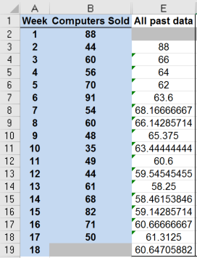
2. Forecasting: extrapolation methods
See Excel data: Tablet Computer Sales.xlsx
Forecast
Extrapolation method #2:
Use the average of all historic data to forecast next period’s data
average
Sales forecast for week 7 = average of sales in weeks 1 through 6

Slide 20

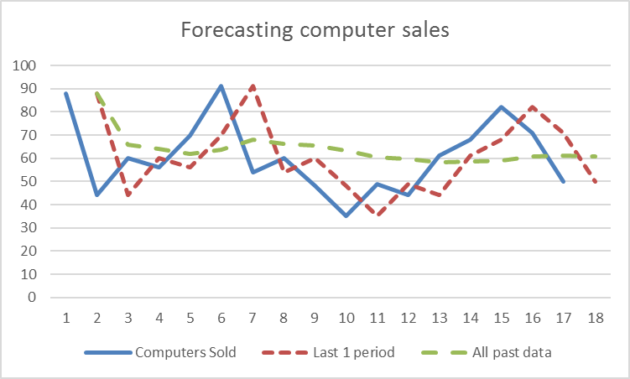
2. Forecasting: extrapolation methods
See Excel data: Tablet Computer Sales.xlsx
Use this period’s data to forecast next period’s data
Use the average of all historic data to forecast next period’s data
Which of the two methods provides a better forecast?
Forecast #1 is very volatile. Current value depends on 1 previous value. Forecast responds immediately to changes in the time series. An extreme value would result in an extreme forecast.
Forecast #2 is very “smooth”. Current value depends (equally) on all past data. Extreme values have small effect on the forecasts.
Actual

Slide 21
Forecast accuracy: error metrics
Comparing forecasts (mathematically):
Mean Absolute Deviation
Mean Squared Error
Root Mean Squared Error
n = # forecast values

Slide 22
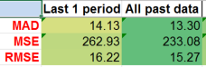

2. Forecasting: extrapolation methods
Use this period’s data to forecast next period’s data
Use the average of all historic data to forecast next period’s data
Which of the two methods provides a better forecast?
See Excel data: Tablet Computer Sales.xlsx
Actual

Slide 23
2. Forecasting: extrapolation methods
Use this period’s data to forecast next period’s data
Drawbacks:
Forecast relies on only one data point = the most recent past!
All other historic data are ignored.
Such forecasts are very volatile and sensitive to extremes.

Slide 24
2. Forecasting: extrapolation methods
Use this period’s data to forecast next period’s data
Drawbacks:
Forecast relies on only one data point = the most recent past!
All other historic data are ignored.
Such forecasts are very volatile and sensitive to extremes.
Use the average of all historic data to forecast next period’s data
Drawbacks:
Assumes that future observations depend on recent and very remote past.
All historic data are given the same weight.

Slide 25
2. Forecasting: extrapolation methods
3. Simple Moving Average method
Is a smoothing method (similar to method #2 that uses all historic data)
Idea: Future observations are similar to recent past but only up to the most recent k observations (not all historic data)
Take the average of the last k values
Intuitively, for k=3:

Slide 26
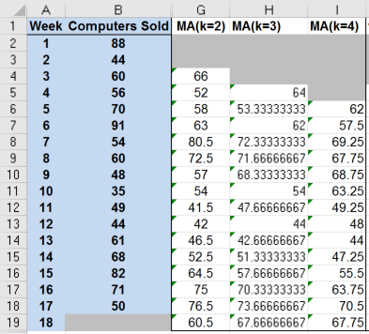
2. Forecasting: extrapolation methods
See Excel data: Tablet Computer Sales.xlsx
3. Simple Moving Average method
Forecast
Forecast
Forecast
average
MA(k=2): uses average of last 2 periods’ data for the forecast
MA(k=3): uses average of last 3 periods’ data for the forecast
MA(k=4): uses average of last 4 periods’ data for the forecast
average
average

Slide 27
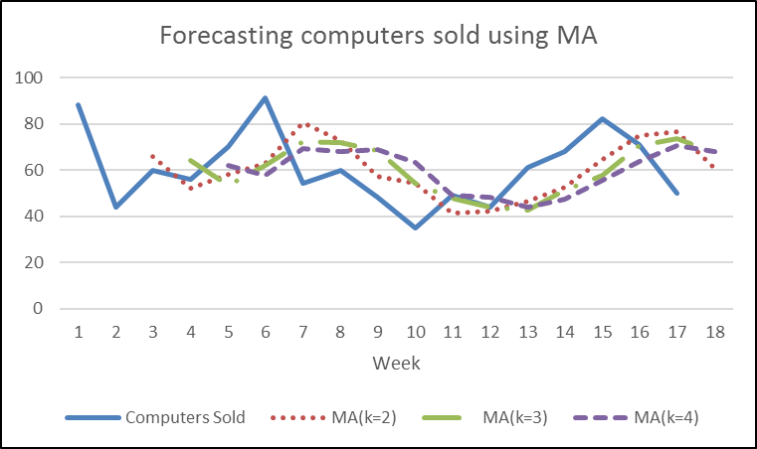
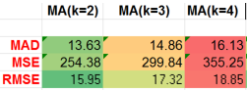

2. Forecasting: extrapolation methods
See Excel data: Tablet Computer Sales.xlsx
3. Simple Moving Average method

Slide 28
2. Forecasting: extrapolation methods
3. Simple Moving Average method
Drawback:
All k previous observations are given the same weight.
(e.g., if k=3, then sales from 3 quarters ago are equally important in forecasting this quarter’s sales as are the sales from 1 quarter ago.)

Slide 29
2. Forecasting: extrapolation methods
3. Simple Moving Average method
Drawback:
All k previous observations are given the same weight.
(e.g., if k=3, then sales from 3 quarters ago are equally important in forecasting this quarter’s sales as are the sales from 1 quarter ago.)
4. Weighted Moving Average method
Idea: Each past observation is assigned a weight.
Forecast = the weighted average of past k values.
More recent observations are typically given a higher weight, more distant – a lower weight.
All weights must add up to 1.
For example, for WMA(k=3), we can use weights 0.5 for t-1, 0.3 for t-2, and 0.2 for t-3.

Slide 30
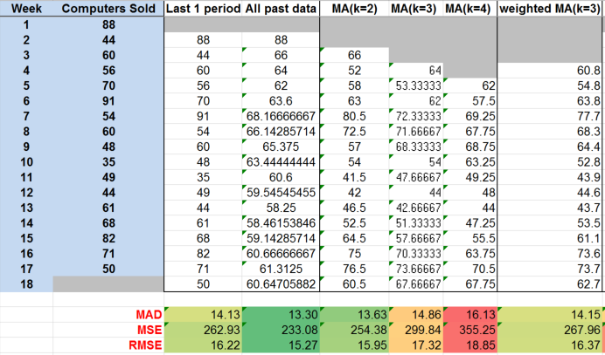
2. Forecasting: extrapolation methods
See Excel data: Tablet Computer Sales.xlsx
4. Weighted Moving Average method
Forecast
77.7 = 0.5*91
+ 0.3*70
+ 0.2*56
weights
actual values

Slide 31
2. Forecasting: extrapolation methods
4. Weighted Moving Average method
Drawback:
Weights are subjective.

Slide 32
2. Forecasting: extrapolation methods
4. Weighted Moving Average method
Drawback:
Weights are subjective.
5. Exponential Smoothing method
Idea: Each past observation is assigned a weight.
More recent observations are given a higher weight, more distant – a lower weight.
Weights decrease smoothly.
Weights depend on the smoothing constant α (between 0 and 1).
Drawback: We decide on the value of α, so this method is also somewhat subjective.

Slide 33
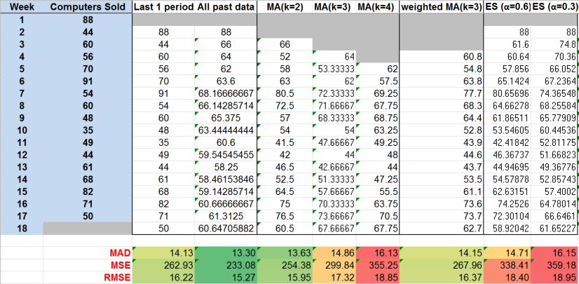
2. Forecasting: extrapolation methods
See Excel data: Tablet Computer Sales.xlsx
5. Exponential Smoothing method
Forecast
= 88 from Week 1

Slide 34
2. Forecasting: extrapolation methods
See Excel data: Tablet Computer Sales.xlsx
5. Exponential Smoothing method
Forecast
= 0.3*70 +0.7*66.052

Slide 35
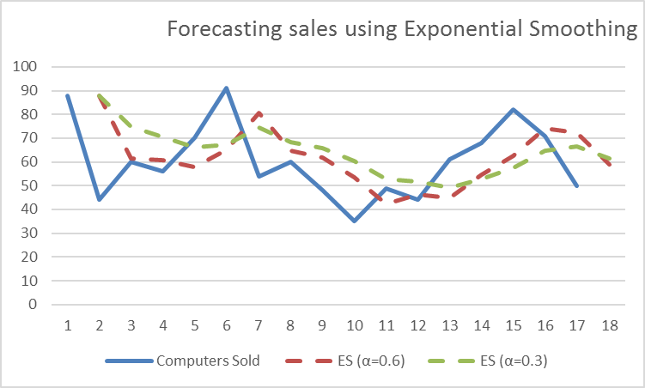
2. Forecasting: extrapolation methods
See Excel data: Tablet Computer Sales.xlsx
5. Exponential Smoothing method
α = 0.3
α = 0.6
Actual
Higher smoothing constant α → more volatile, less smooth

Slide 36
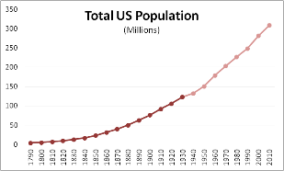
3. Forecasting: regression-based methods
Forecasting techniques for NON-STATIONARY data

Slide 37
In this lecture:
What is time series modeling?
Forecasting: extrapolation methods
Two simplest extrapolation methods
Use last period’s data as the forecast for next period
Use the average of all historical data as the forecast for next period
Moving Average extrapolation
Simple Moving Average (MA) of order k
Weighted Moving Average
Exponential Smoothing extrapolation
Exponential Smoothing with smoothing constant α
Forecasting: regression-based methods
Time series regression model with trend
Time series regression model with seasonality
Controlling for other causal variables
Autoregression (AR) model of order k
Forecast accuracy: error metrics
Mean Absolute Error (MAE)
Mean Square Error (MSE)
Root Mean Square Error (RMSE)

Slide 38
3. Forecasting: regression-based methods
a) Forecasting time series data with trend

Slide 39
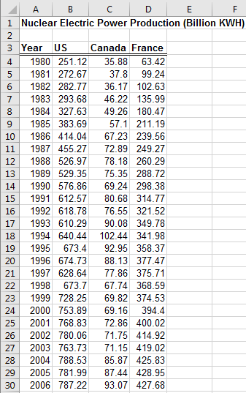
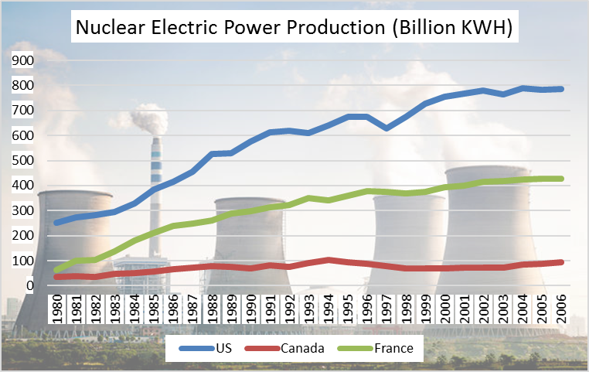
3. Forecasting: regression-based methods
See Excel data: Nuclear Power.xlsx
non-stationary (trend)

Slide 40
3. Forecasting: regression-based methods
Linear trend: Add trend (t) into regression as an explanatory variable.
y_{t} = a + b*t

Slide 41
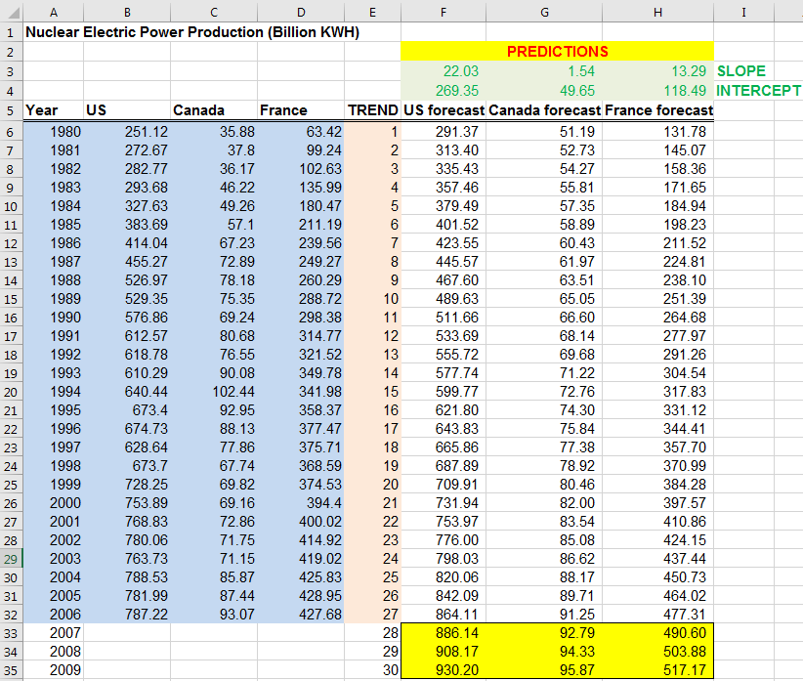
3. Forecasting: regression-based methods
See Excel data: Nuclear Power.xlsx
Linear trend: Add trend into regression as an explanatory variable.
Forecast for years 2007, 2008, 2009
TREND

Slide 42
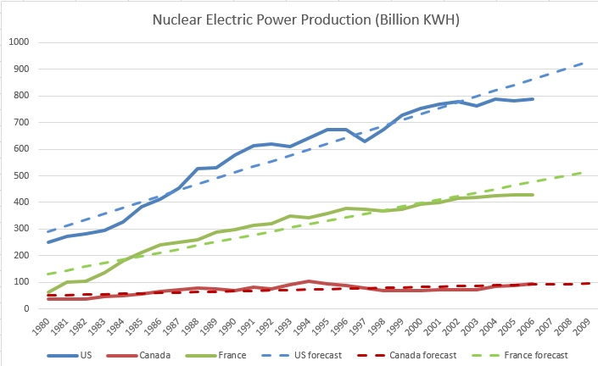
3. Forecasting: regression-based methods
See Excel data: Nuclear Power.xlsx
Linear trend: Add trend into regression as an explanatory variable.
U.S.
France
Canada

Slide 43
3. Forecasting: regression-based methods
See Excel data: Nuclear Power.xlsx
Linear trend: Add trend into regression as an explanatory variable.
U.S.
France
Canada
Is the trend non-linear (quadratic)?

Slide 44
3. Forecasting: regression-based methods
Nonlinear trend types:
Polynomial trend:
Quadratic = polynomial or order 2. Add t and t² into regression as explanatory variables.
y_{t} = a + b*t + c*t²
Cubic = polynomial or order 3. Add t , t² , and t³ into regression as explanatory variables.
y_{t} = a + b*t + c*t² + d*t³
2. Exponential trend:
ln(y_{t}) = a + b*t

Slide 45
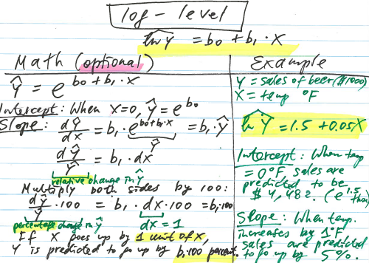
3. Forecasting: regression-based methods
Nonlinear trend types:
Polynomial trend:
Quadratic = polynomial or order 2. Add t and t² into regression as explanatory variables.
y_{t} = a + b*t + c*t²
Cubic = polynomial or order 3. Add t , t² , and t³ into regression as explanatory variables.
y_{t} = a + b*t + c*t² + d*t³
2. Exponential trend:
ln(y_{t}) = a + b*t
Forecasted y_{t} = eª * e^{b*t}
With each period, y is forecasted to increase by b*100 percent.
Recall Lecture 05:

Slide 46
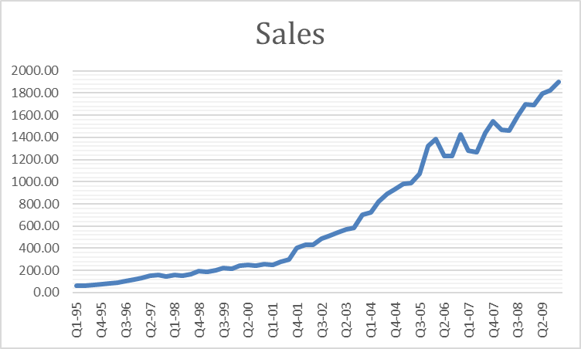
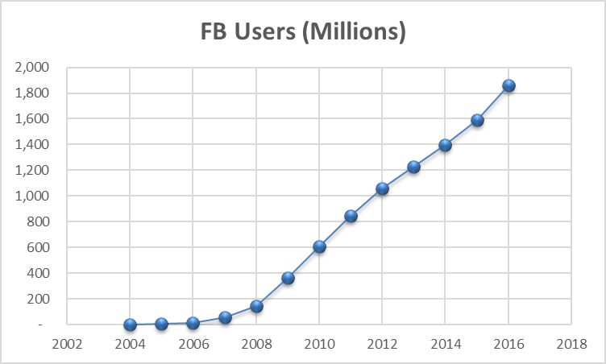
3. Forecasting: regression-based methods
See Excel data:
PC Device Sales.xlsx
Forecast quarterly sales using
polynomial and exponential trends.
Facebook.xlsx
Forecast number of active Facebook users
using polynomial and exponential trends.

Slide 47
3. Forecasting: regression-based methods
b) Forecasting time series data with seasonality

Slide 48
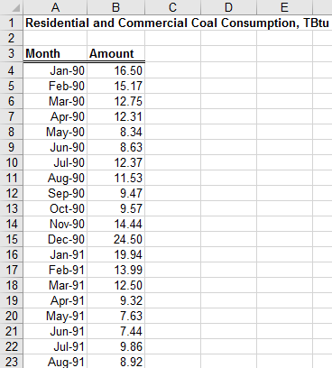
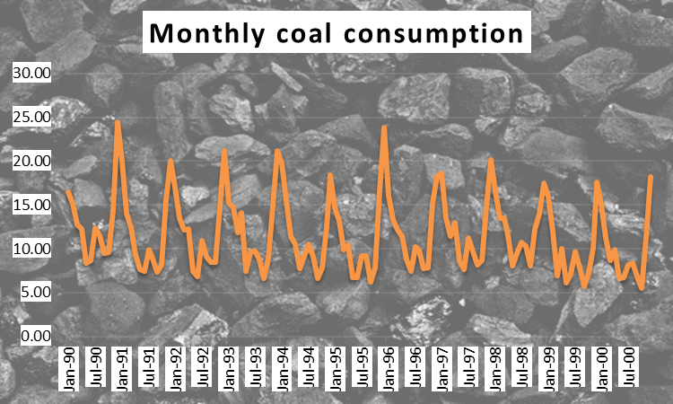
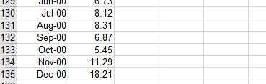
3. Forecasting: regression-based methods
See Excel data: Coal Consumption.xlsx
…
non-stationary (seasonality)

Slide 49
3. Forecasting: regression-based methods
See Excel data: Coal Consumption.xlsx
Seasonality: Add each period’s dummy into regression as explanatory variables.

Slide 50
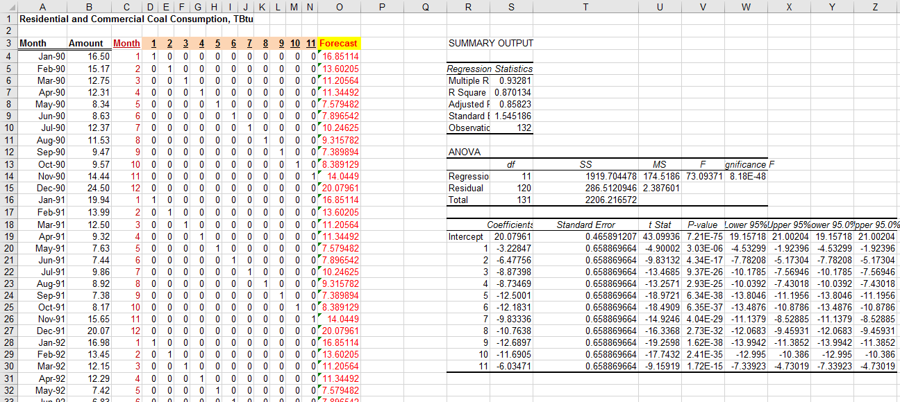
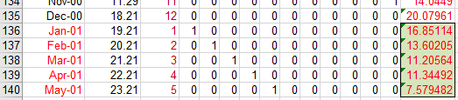
3. Forecasting: regression-based methods
See Excel data: Coal Consumption.xlsx
Seasonality: Add each period’s dummy into regression as explanatory variables.
Forecast for Jan 2001 – May 2001

Slide 51
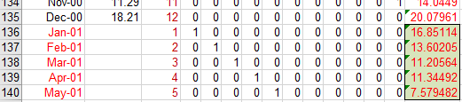
3. Forecasting: regression-based methods
See Excel data: Coal Consumption.xlsx
Seasonality: Add each period’s dummy into regression as explanatory variables.
= intercept + sum( dummy  coefficient)
Forecast for Jan 2001 – May 2001

Slide 52
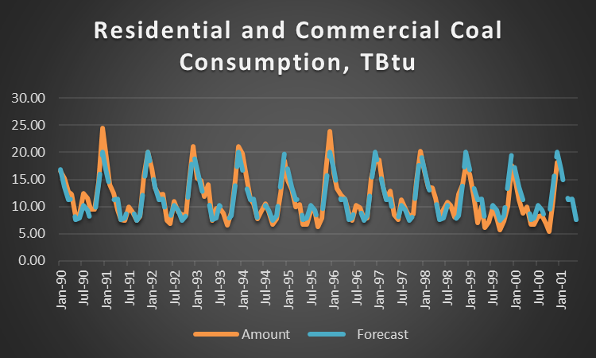
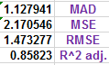
3. Forecasting: regression-based methods
See Excel data: Coal Consumption.xlsx
Seasonality: Add each period’s dummy into regression as explanatory variables.

Slide 53
3. Forecasting: regression-based methods
a)+b) Forecasting time series data with trend
and seasonality
Let’s ignore the fact that on this graph volatility is increasing with time…

Slide 54
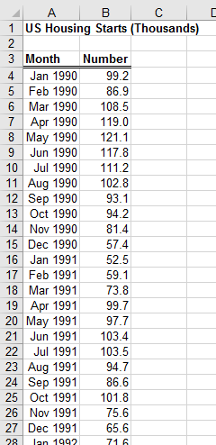
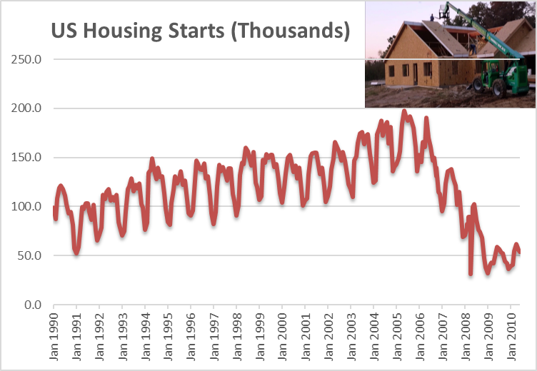
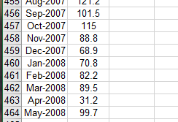
3. Forecasting: regression-based methods
See Excel data: Housing Starts.xlsx
…
non-stationary (seasonality and trend)

Slide 55
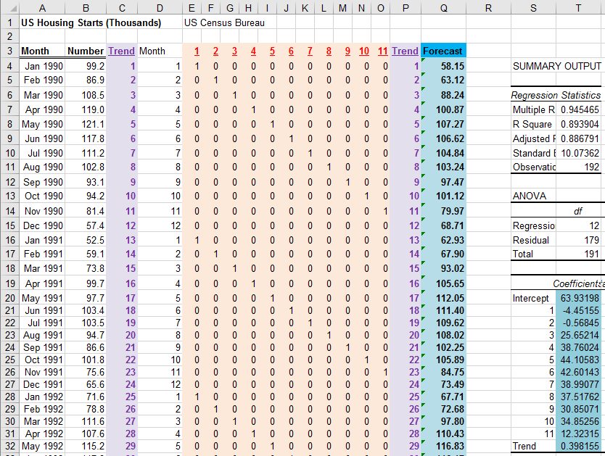
3. Forecasting: regression-based methods
See Excel data: Housing Starts.xlsx
Seasonality + trend: Add each period’s dummy and trend into regression as explanatory variables.
Let’s use only data during 1990-2005

Slide 56
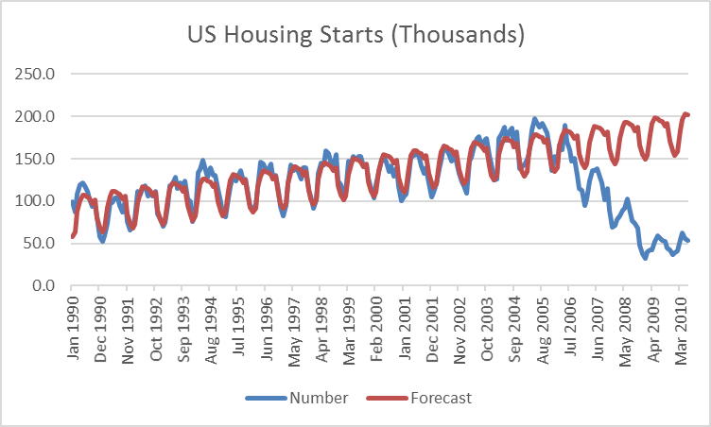
3. Forecasting: regression-based methods
See Excel data: Housing Starts.xlsx
Seasonality + trend: Add each period’s dummy and trend into regression as explanatory variables.
Any ideas on how to model the sudden change in trend?

Slide 57
3. Forecasting: regression-based methods
c) Controlling for other causal variables
In many forecasting applications, other independent variables besides time, such as economic indexes or demographic factors, may influence the time series.

Slide 58
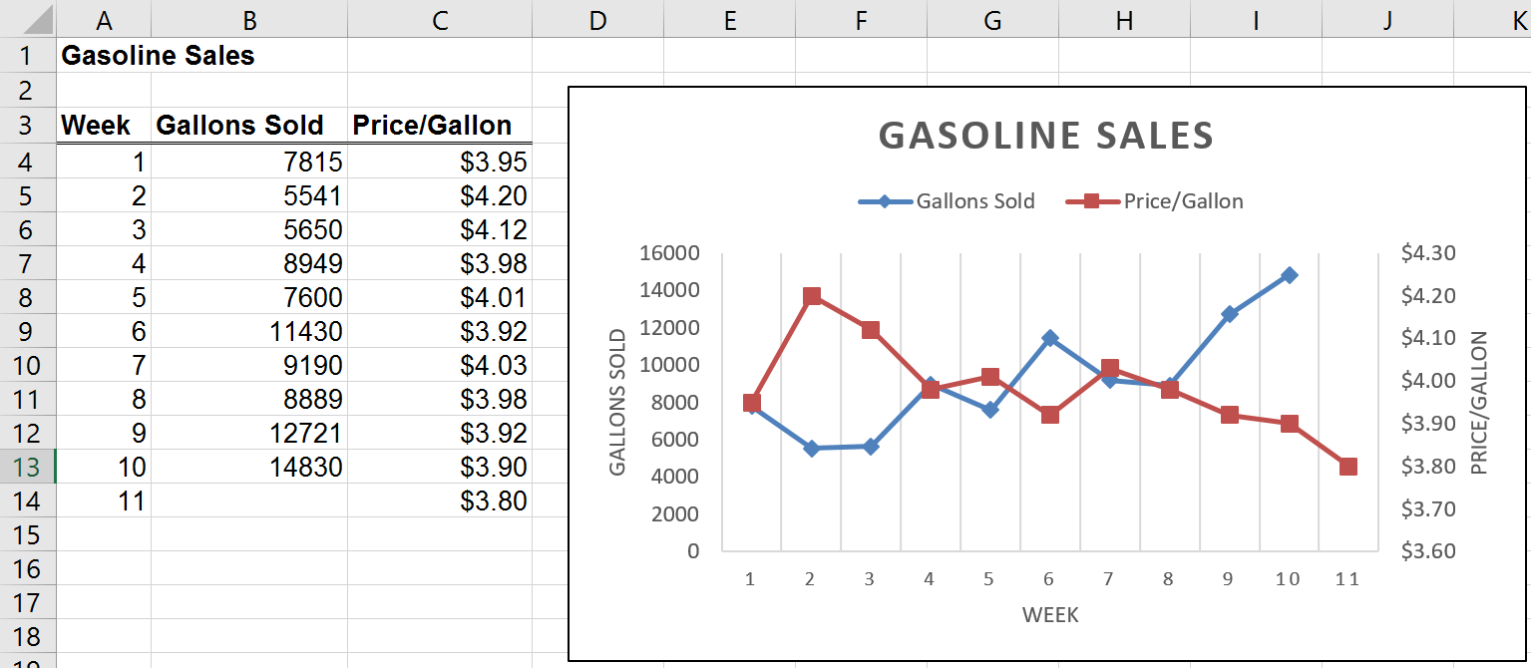
3. Forecasting: regression-based methods
See Excel data: Gasoline Sales.xlsx
non-stationary (trend)

Slide 59
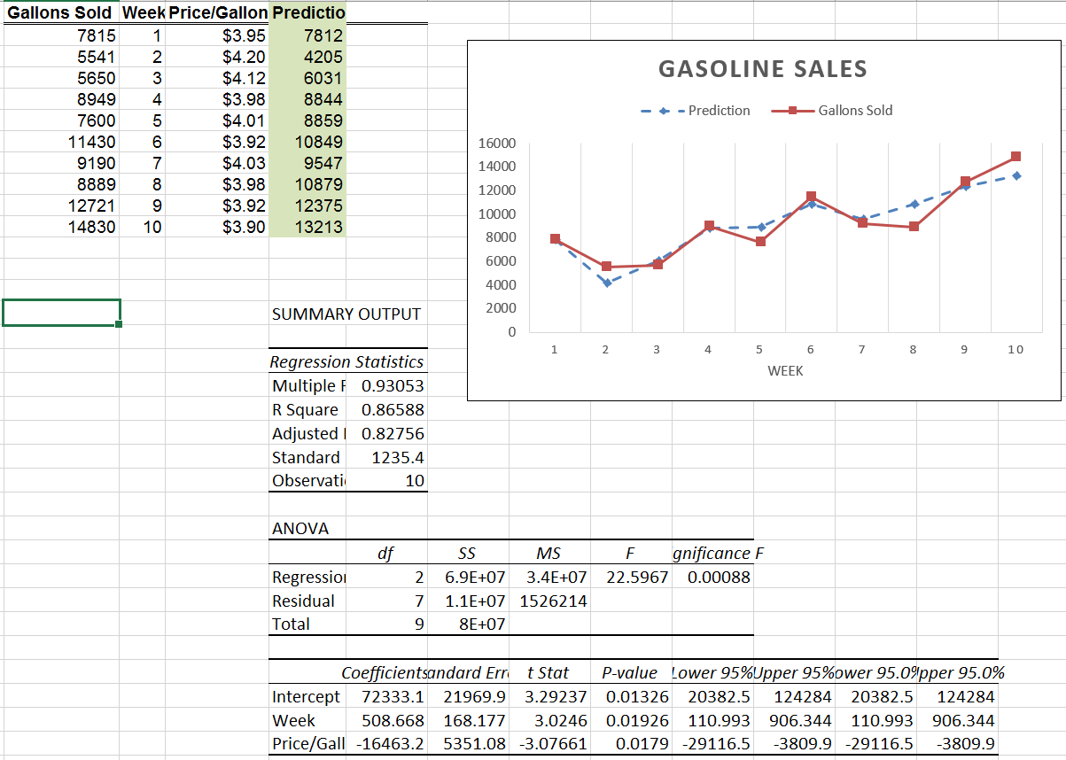
3. Forecasting: regression-based methods
See Excel data: Gasoline Sales.xlsx
Trend + gas prices: Add trend and gas prices into regression as explanatory variables.

Slide 60
3. Forecasting: regression-based methods
d) Autoregression models
Idea: Regress the current value of the time series on past (lagged values).
AR(1) means include the first lag
AR(2) means include the first two lags
AR(3) means include the first three lags
…

Slide 61
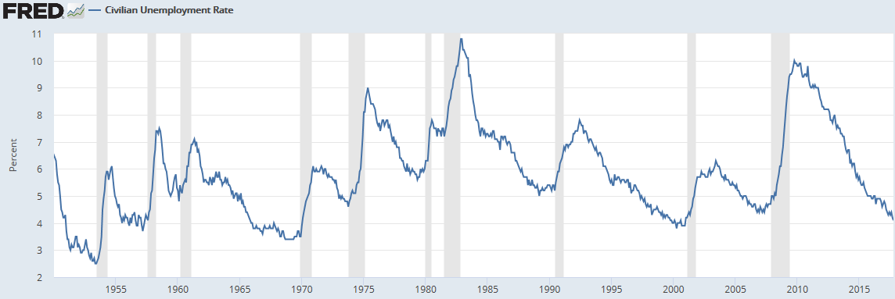
3. Forecasting: regression-based methods
Monthly unemployment rate in the US: 1950/01 – 2017/10
https://fred.stlouisfed.org/series/UNRATE
Try up to k = 4 lags. Keep in regression if the coefficients are statistically significant.

Slide 62
In this lecture:
What is time series modeling?
Forecasting: extrapolation methods
Two simplest extrapolation methods
Use last period’s data as the forecast for next period
Use the average of all historical data as the forecast for next period
Moving Average extrapolation
Simple Moving Average (MA) of order k
Weighted Moving Average
Exponential Smoothing extrapolation
Exponential Smoothing with smoothing constant α
Forecasting: regression-based methods
Time series regression model with trend
Time series regression model with seasonality
Controlling for other causal variables
Autoregression (AR) model of order k
Forecast accuracy: error metrics
Mean Absolute Error (MAE)
Mean Square Error (MSE)
Root Mean Square Error (RMSE)

